Slide 1
Nutrition E-Book
Written By: Nicole Marchand Aucoin, MS, RD
Registered Dietitian & Owner Healthy Steps Nutrition & CrossFit HSN

Slide 2
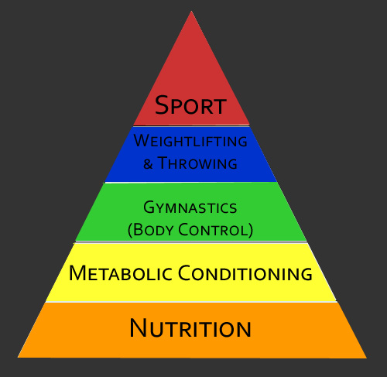
A Solid Foundation
Where Does Your Nutrition Fit In?

Slide 3
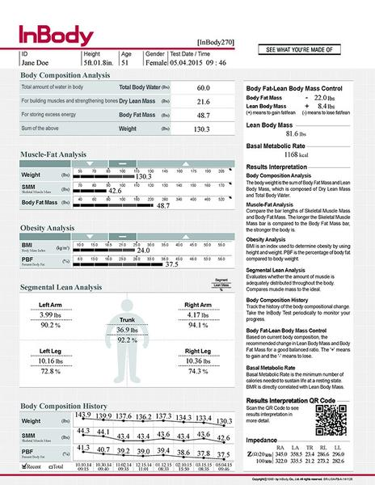
Determine Your Baseline &
Track Your Progress
We recommend tracking more than just your body weight by looking at measurements, body fat and muscle mass
Re-check biometrics every 2-4 weeks
At Healthy Steps Nutrition, we use an InBody scan to determine your baseline and track your progress

Slide 4

Have A Plan
Take time to prep your staples on the weekend
Check out the website for some awesome recipes! https://healthystepsnutrition.com/healthy-recipes/
Create a menu for the week
Try using a muffin tin, crockpot or instant pot when prepping food to save time
Pre-wash and cut fruits and veggies for convenience

Slide 5

Drink Up!
Water plays a vital role with all metabolic purposes
Dehydration can decrease performance up to 20%!
Try to drink at least 80 ounces of water per day
Don’t like the taste of water? Try adding fresh fruit (watermelon, strawberries, pineapple, cucumber, mint)
Trips to drink more water: carry a bottle with you, log your water throughout the day, drink with a straw

Slide 6
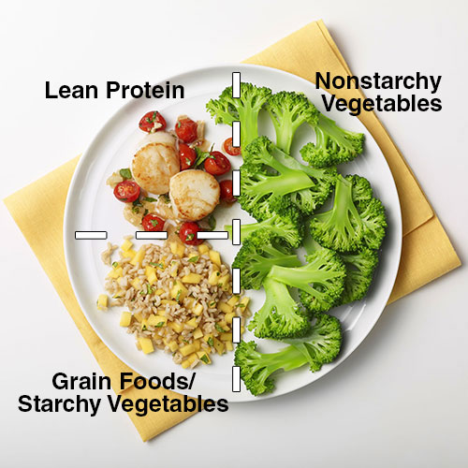
Balance Your Plate
Incorporating all macronutrients (protein, carbs & fats) into your meals and snacks will help keep you full and satisfied
Try to load up on the non-starchy veggies (1/2 your plate) and eat those first!
Next, choose a lean meat (3-6 ounces)
Lastly, pick a low glycemic starch that is high in fiber and low in sugar to help keep you full and satisfied until the next meal/snack

Slide 7
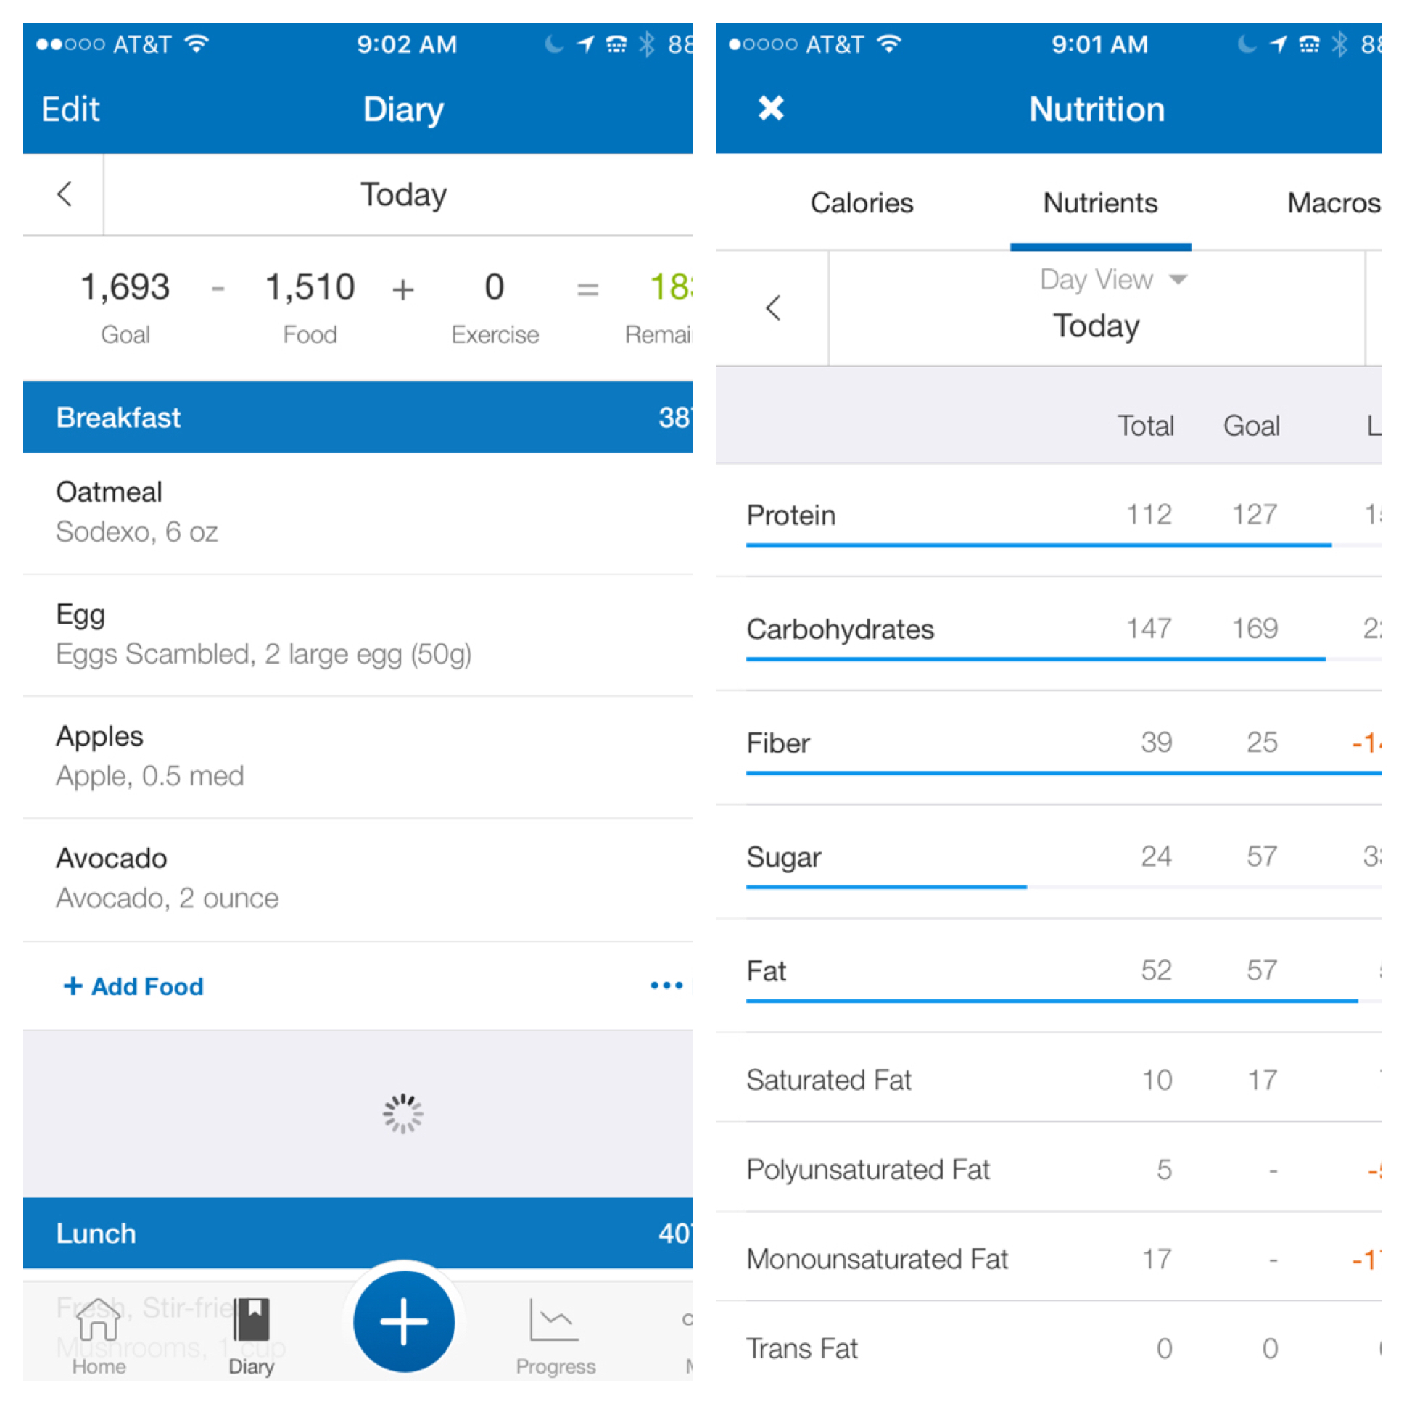
Track Your Food
Keeping track of your intake is an extra step of accountability that will help you be aware of what exactly you are eating
We LOVE MyFitnessPal because it is user friendly and has a large food bank to easily find the food brands you are consuming
Short on time? Try a food photo journal and just take pictures of everything you eat

Slide 8

Let’s Look At All The Pieces Of The Puzzle
Drink at least 80 ounces of water per day
Eat every 3-4 hours
Balance your macronutrients: 40% carbs, 30% protein, 30% fat
Slow down: your brain is 15 minutes behind your belly!
Focus on lean sources of meat, plant based sources of fat and low sugar/high fiber carbohydrates
Eat around your workouts (don’t workout on an empty stomach)
Try to get at least 6 hours of sleep per night
Exercise regularly!

Slide 9

WHY Use Healthy Steps Nutrition?
GUIDED.
TESTED.
PROVEN.
Program Written By Registered Dietitian & CrossFit Affiliate Owner, Nicole Marchand Aucoin

Slide 10
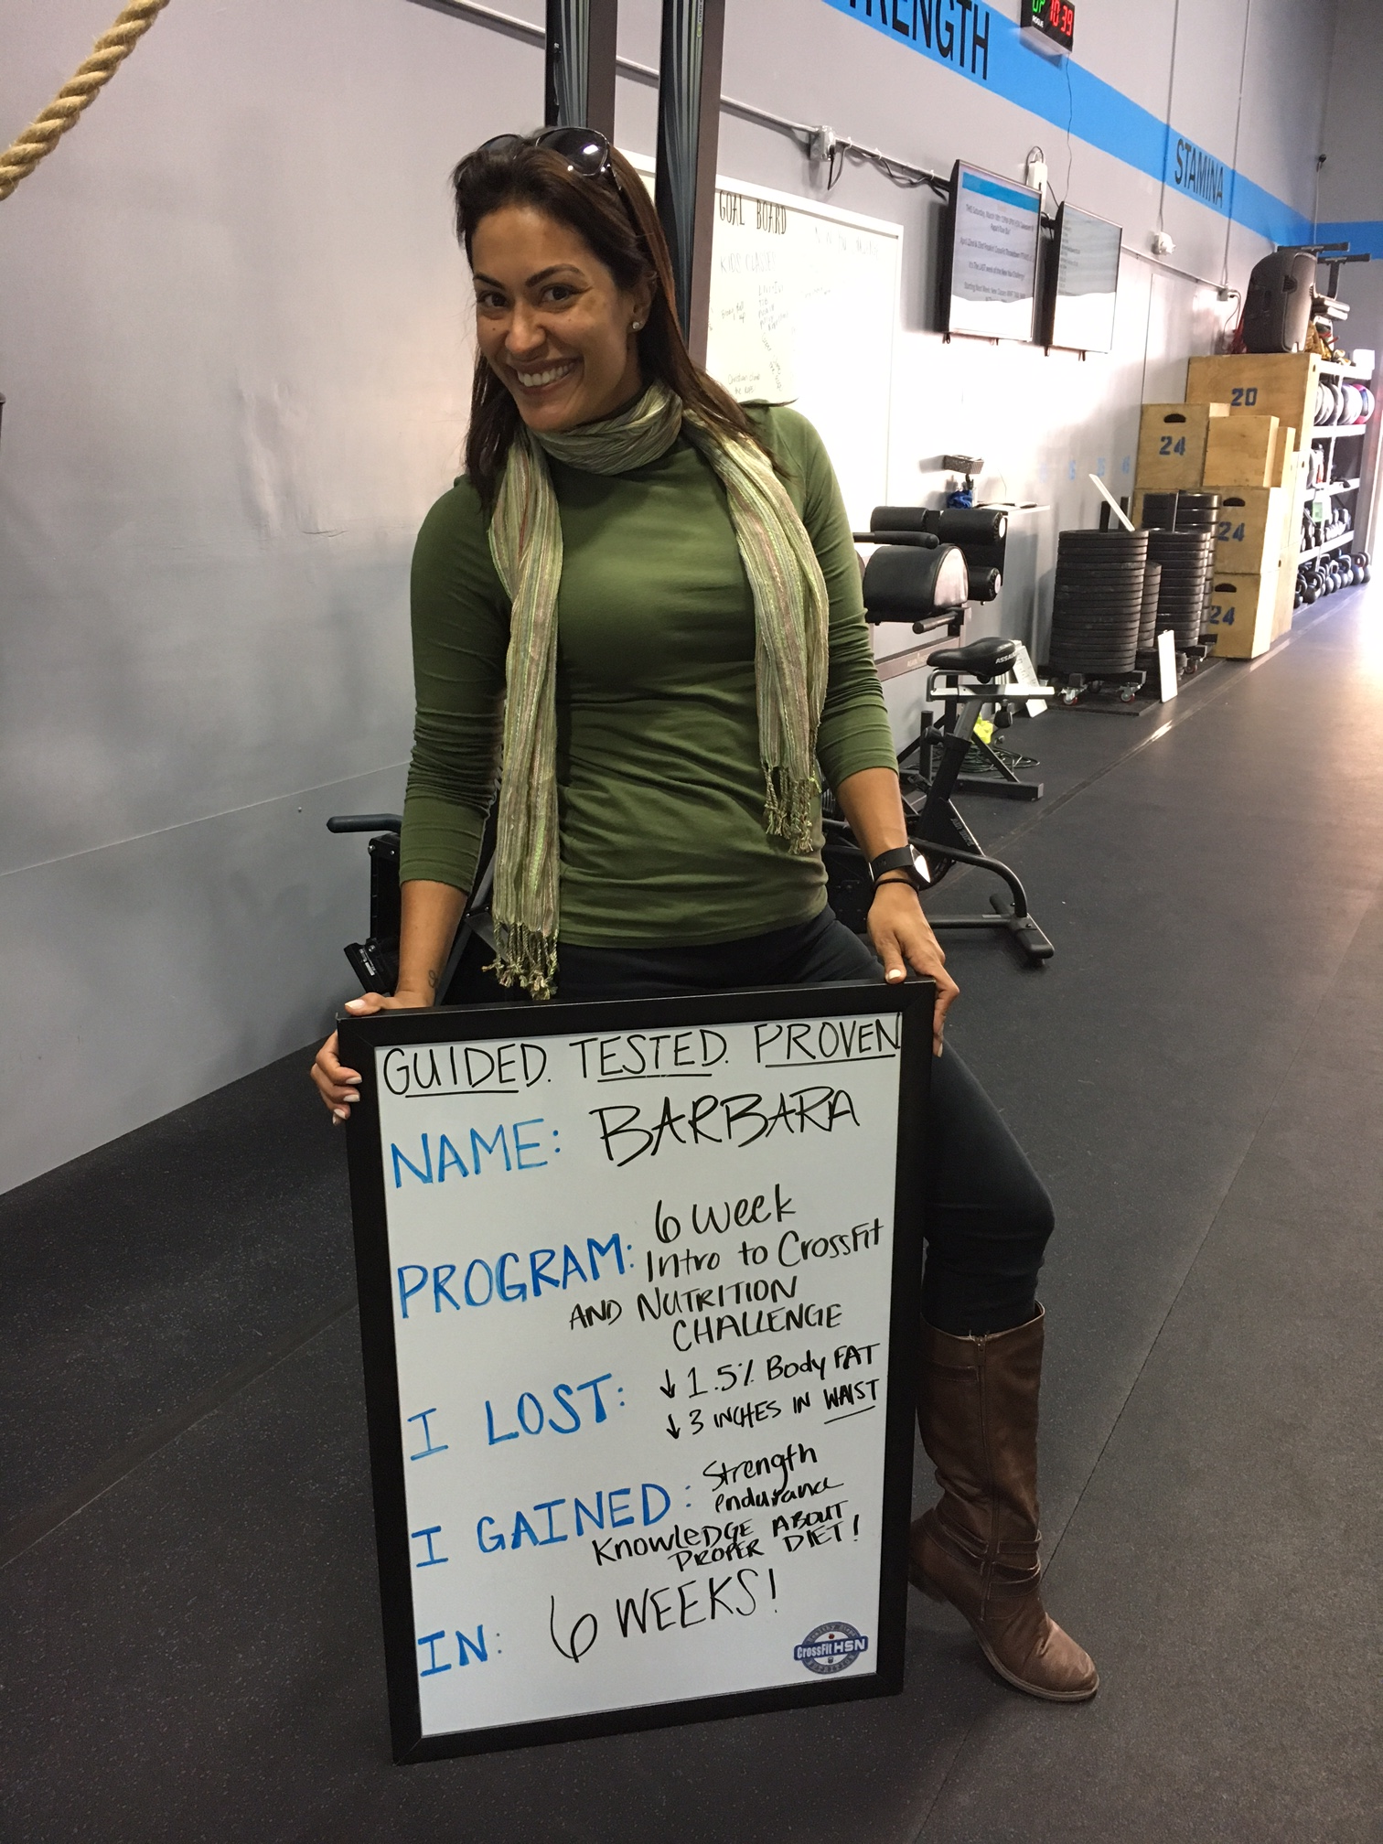
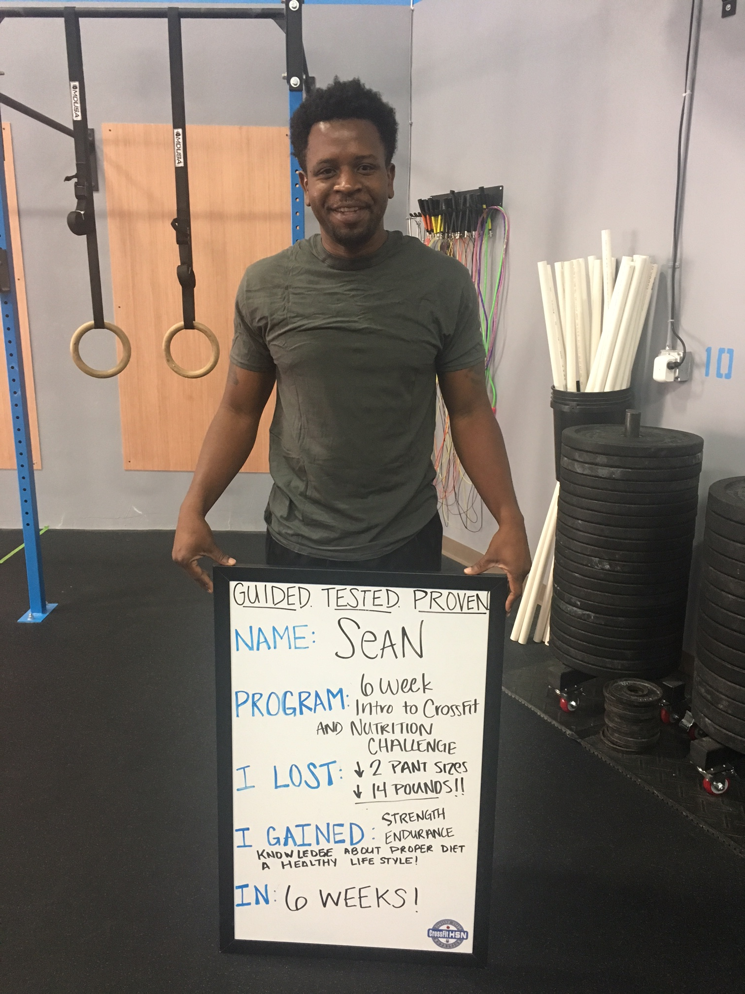
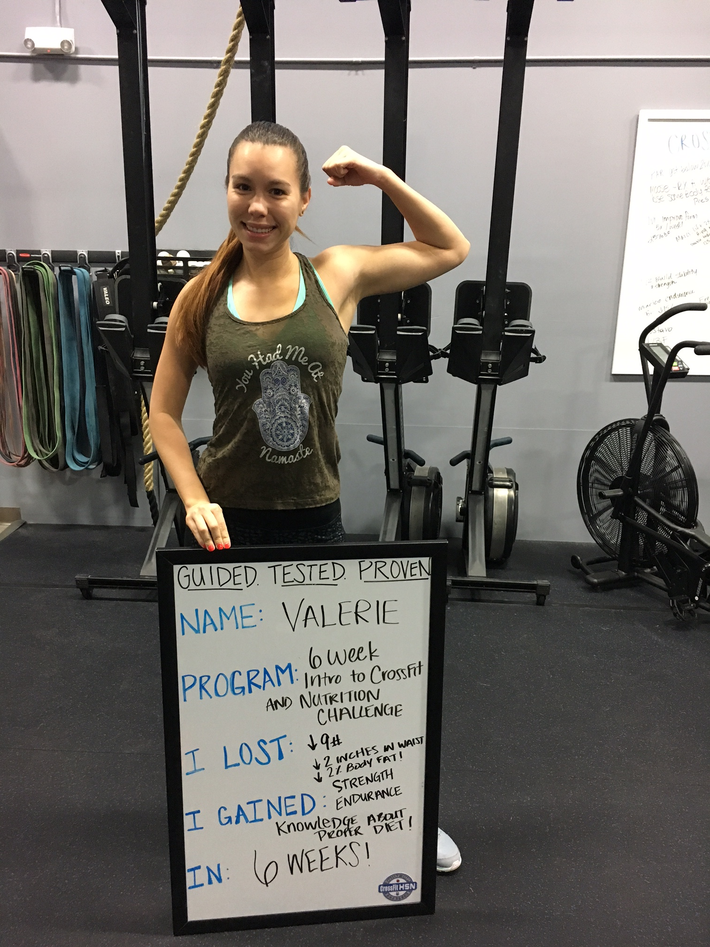
PROVEN Success!

Slide 11
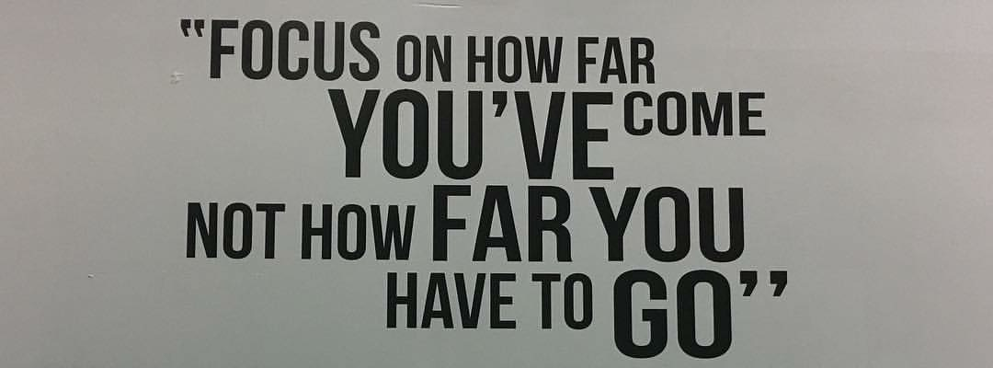
Interested In More Information?
Our Programs:
Group & Corporate Challenges
Individual Nutrition Counseling
Sports Nutrition
Pediatric Nutrition
Book Your Appointment Online: https://healthystepsnutrition.com/onsite-nutrition-programs/

